Slide 1
Coursera Capstone Project
By Jason Chen

Slide 2
Introduction
Background:
Thousand Oaks, CA has a large Asian population compared to neighboring cities. We will find the best location in Thousand Oaks to open a Chinese restaurant.
Problem:
Find the best location to open a Chinese restaurant in Thousand Oaks, CA using the following criteria:
We would want the location to have no other Chinese restaurants nearby.
We would also want the restaurant to be near the center of the city, busy commercial district, or heavy traffic area.
Interest:
People interested in starting a Chinese restaurant in Thousand Oaks, CA would find this helpful. This project will give them the best locations, as well as the locations of other Chinese restaurants and other restaurants in the area.

Slide 3
Data
We will find the best location for the Chinese Restaurant using the following criteria:
The number of Chinese restaurants in the neighborhood
The distance of the location from city center
We will use the following programs and modules as data sources:
Geopy module to find coordinates and addresses.
Folium to provide the maps of the city and heatmaps of possible locations.
Foursquare to provide the restaurant addresses and locations.

Slide 4
Methodology
In this project, we will find areas of Thousand Oaks that have low restaurant density, particularly those with low number of Chinese restaurants
Firstly, we will collect the data required for analysis. We will focus the analysis near the center of Thousand Oaks. We will also use the Foursquare API to locate all of the Chinese restaurants in the area.
The second step will to calculate the density of restaurants in different areas of Thousand Oaks. We will then identify the areas near the center of the city with a lower number of restaurants nearby as well as no more than 1 or 2 Chinese restaurants in the area.
The final step will be to create clusters of locations that meet the requirements previously stated. We will then create a final map to show the best possible locations to start a Chinese restaurant.

Slide 5
Results/Discussion
The analysis shows that there are pockets of low restaurant density close to city center. As well as areas with few Chinese restaurants nearby. These were clustered to create zones of interest which contain possible location candidates. Addresses of centers of those zones are provided using reverse geocoding.
The result show zones that contain the largest number of restaurant locations based on number of and distance between other restaurants.
However, some of these zones may not be the best locations to start a new restaurant. Therefore, these zones should serve as a starting point for more detailed analysis to determine the viability of the locations. Other factors to look for in a more detailed analysis would be the visibility of the restaurant, the price of the location, proximity to highways or major roads, etc.

Slide 6
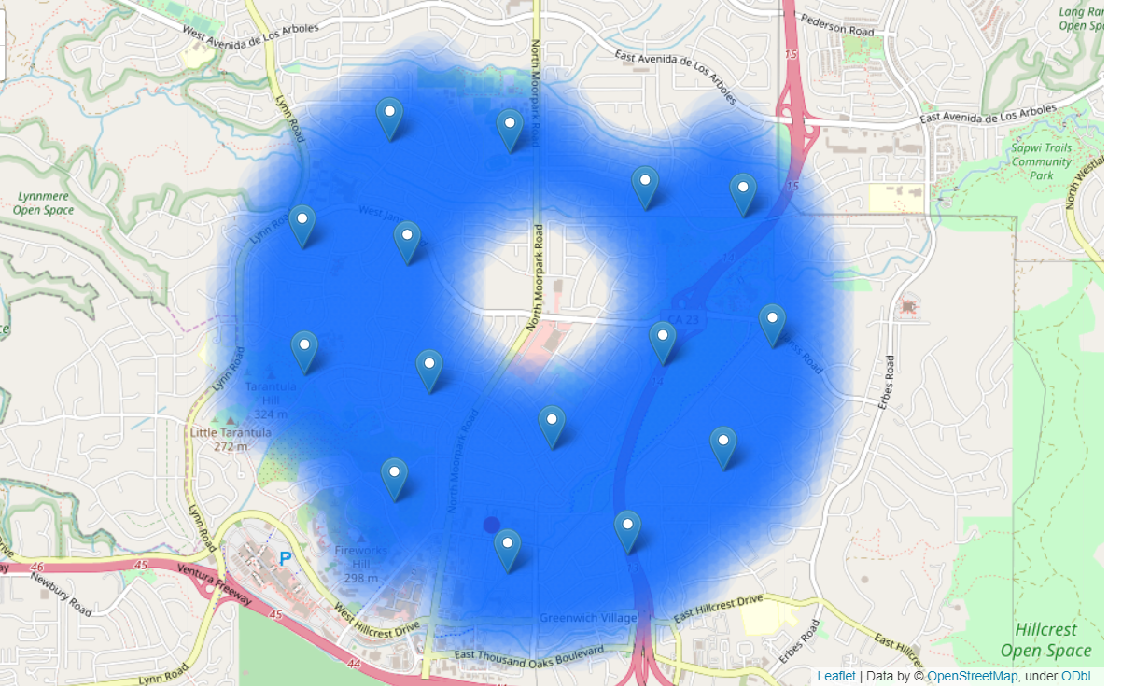
Clusters of the Best Locations:

Slide 7
Conclusion
In this project, we identified possible locations close to center with a low number of restaurants nearby to find the best possible location for a new Chinese restaurant.
We calculated the restaurant density with the Foursquare API and created heatmaps of locations that follow the requirements regarding existing nearby restaurants.
Finally, we clustered those locations to create zones of interest, that contain good possible locations, and addresses of the zone centers can be used as starting points for more detailed data analysis.
More analysis would be needed to find the best possible locations. Other factors that would need to be considered include, the appeal of each location, proximity to major roads, location availability, prices, etc.

